Slide 1

Sentiment Analysis Unveiled: Words, Emotions, and Insights
By Nandu Nayak

Slide 2
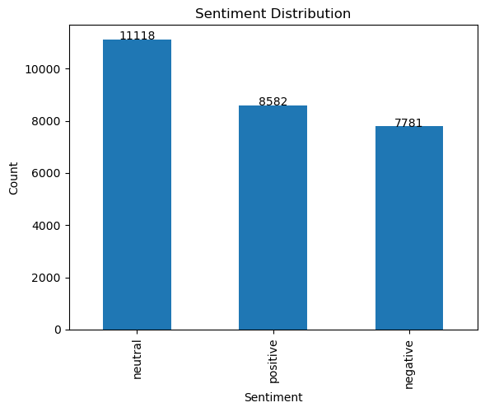
Sentiment Distribution

Slide 3
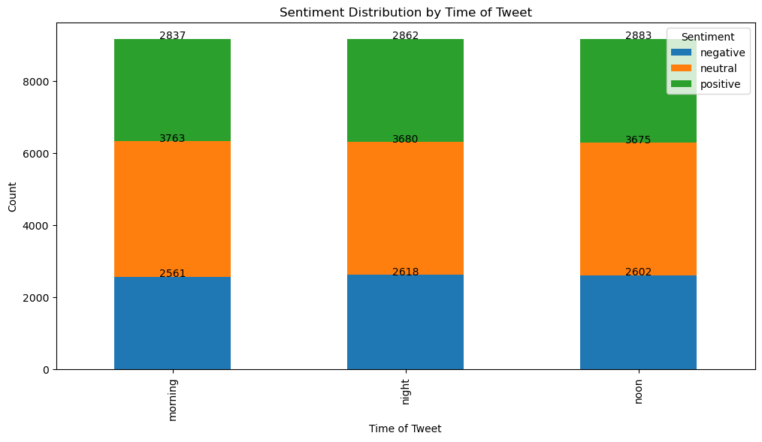
Sentiment with 'Time of Tweet'

Slide 4
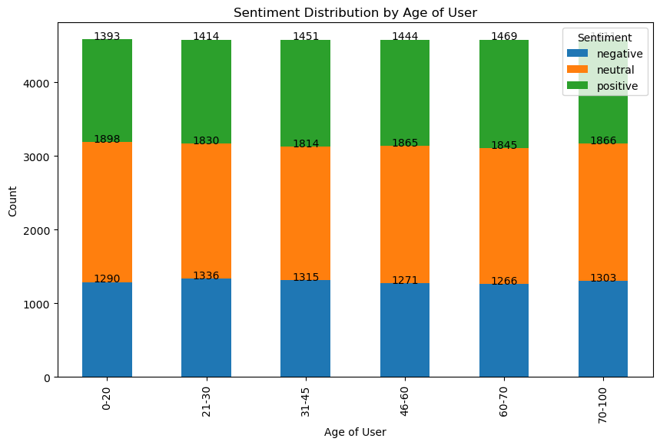
2. Sentiment with 'Age of User’:

Slide 5
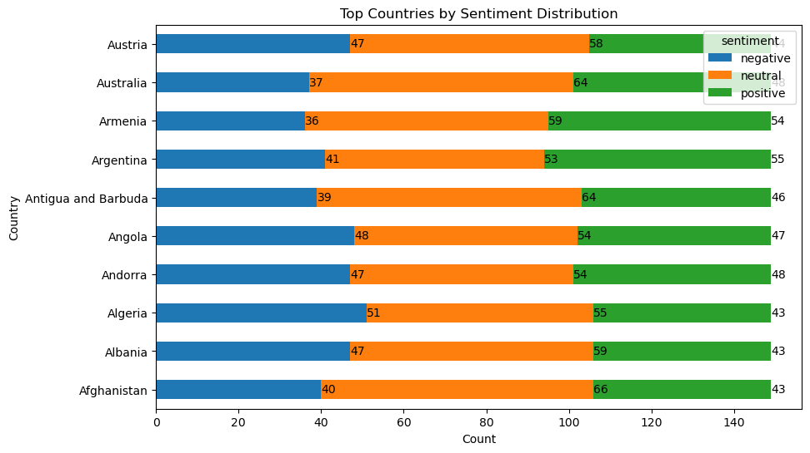
3. Sentiment with Top 'Country'

Slide 6
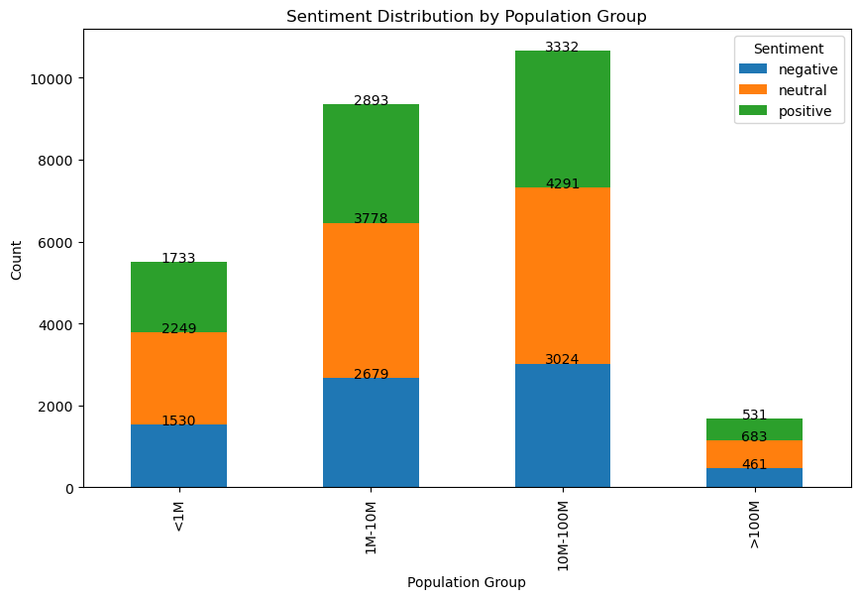
4. Sentiment with 'Population - 2020'

Slide 7
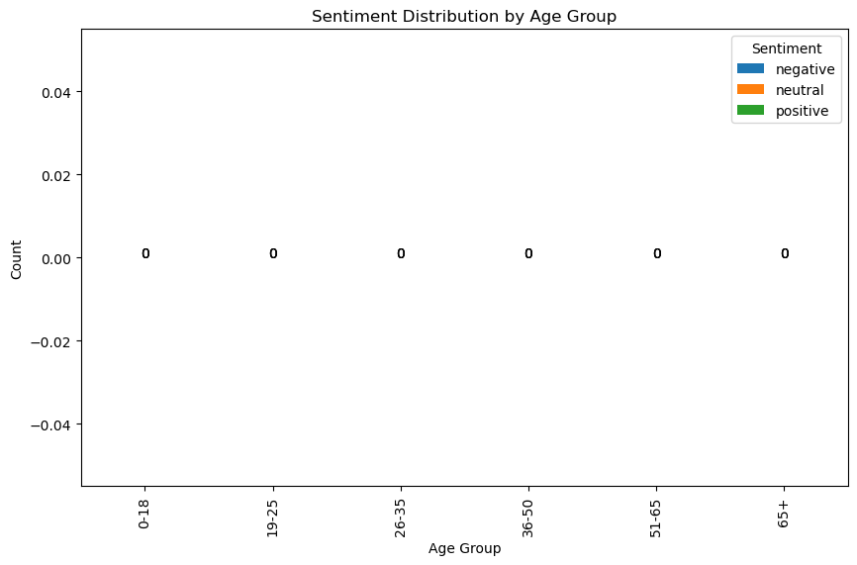
Sentiment with 'Population - 2020'

Slide 8
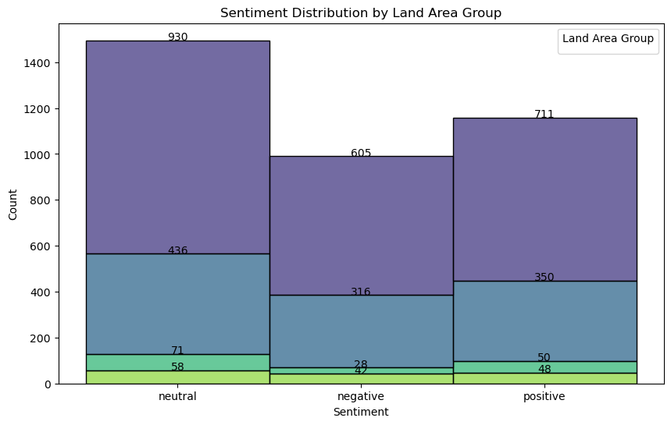
Sentiment Distribution by Land Area Group

Slide 9
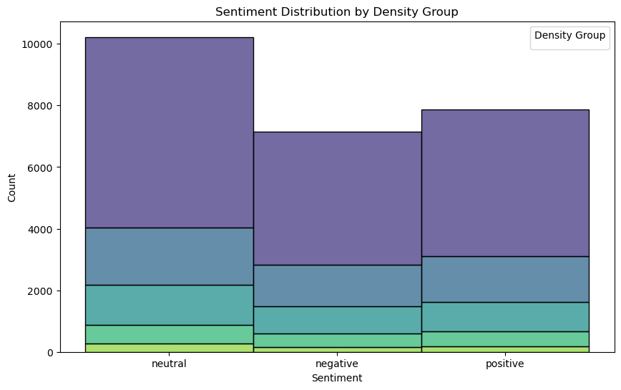
Sentiment Distribution by Density Group

Slide 10
Challenges
Data Quality: Ensuring dataset quality and reliability.
Data Preprocessing: Cleaning and handling text data effectively.
Sentiment Labels: Subjectivity in determining sentiment labels.
Imbalanced Data: Dealing with uneven class distribution.
Stop Words and Noise: Balancing stop words removal with context.
Sentiment Ambiguity: Handling sarcasm, irony, and mixed sentiments.
Contextual Understanding: Capturing nuances and context in text.
Model Selection: Choosing the right sentiment analysis model.
Training Data: Obtaining high-quality labelled data for model training.
Interpretability: Explaining model predictions.
Multilingual Sentiment: Adapting to different languages and models.

Slide 11

The final insights that I can provide based on the analysis are as follows:
Time of Tweet:
Sentiment varies with time; evenings tend to be negative, afternoons neutral, and spread positivity throughout the day.
Age of User:
Users aged 26-35 express more positive sentiment, while those aged 65+ show higher neutral sentiment.
Country:
Sentiment distribution varies by country, indicating cultural differences.
Population & Land Area:
There is no significant correlation between population size or land area and sentiment.
Density (P/Km²):
Sentiment remains relatively stable across population density groups.

Slide 12

Thank you

